Slide 1
DeepFake Image Classification
Sai teja Uppuluri
Nikhil kollipara
Srikanth baddam
Afrid shaik

Slide 2
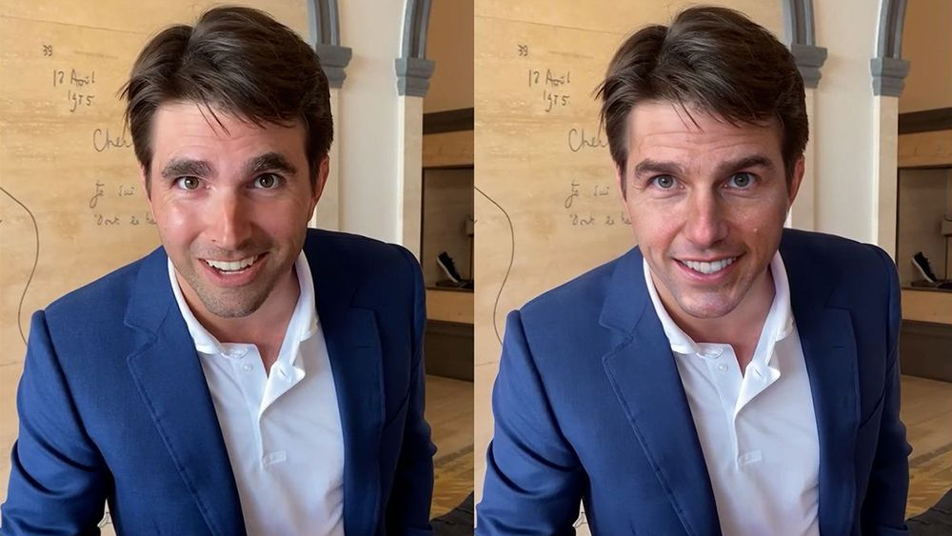
Problem Definition
Deepfakes are AI-generated images or videos that look convincingly real
Can be used maliciously to spread misinformation
Goal: Build a model to classify whether an image is Real or Fake
Deepfake of famous actor Tom Cruise on TikTok
Source: The best deepfake examples | Creative Bloq

Slide 3
Dataset Overview
Source: Kaggle Dataset (Deepfake and Real Images)
Folder structure:
Train → Real / Fake
Validation → Real / Fake
Test → Real / Fake
Balanced dataset (~70k real + 70k fake in training set)
Total 190,335 images

Slide 4
ML Lifecycle Overview
Followed the standard ML lifecycle:
Problem Definition
Data Collection
Preprocessing (OpenCV, resizing, normalization)
Model Selection (CNN + MobileNetV2)
Model Training (Augmentation + TL)
Evaluation (Confusion Matrix, F1 Score)
Deployment (Flask Web App)

Slide 5
Initial Approach – CNN from Scratch
Built a basic CNN with:
3 Conv layers → Flatten → Dense → Dropout
Used custom OpenCV batch generator
Trained on full dataset (70k real + 70k fake)
Achieved decent results (~94% accuracy)
Provided solid learning but limited long-term flexibility

Slide 6
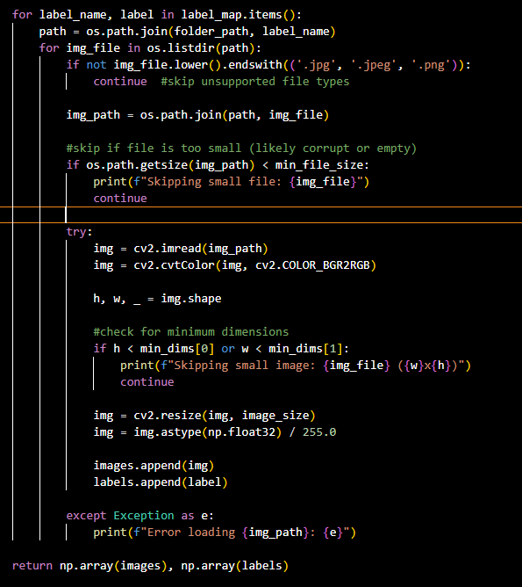
Preprocessing: Initial Model
Used OpenCV to:
Resize images to 128x128
Normalize pixel values to [0, 1]
Images were loaded in batches using a custom generator
Data was balanced and used as-is (no augmentation)

Slide 7
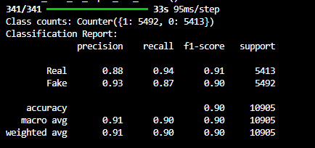
Training & Evaluation (Initial Model)
Model trained using Keras + custom generator
Epochs: 5 | Batch size: 32
Results:
Accuracy: ~94%
Precision (Fake): 0.94
Recall (Real): 0.95
F1 Score: 0.94
Limitations:
Could not capture complex patterns well
No augmentation → weaker generalization

Slide 8
Final Approach – Transfer Learning + Augmentation
Froze base layers and added a custom classifier
Introduced real-time data augmentation using ImageDataGenerator
Flip, shift, zoom, rotation
Aimed for better generalization, speed, and accuracy

Slide 9
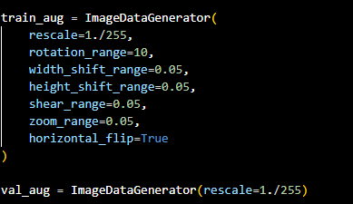
Preprocessing (Final Model)
Used ImageDataGenerator for both:
Augmenting training images in real time
Rescaling validation images
Batch size: 32 | Image size: 128x128
Same dataset, new processing approach

Slide 10
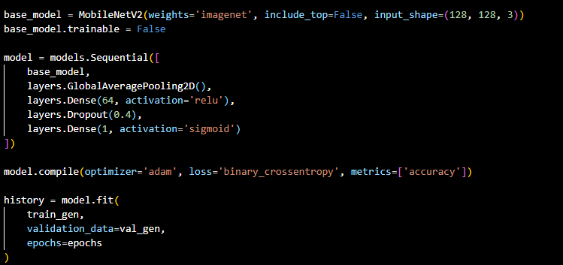
Training & Evaluation (Final Model)
Trained MobileNetV2 head with frozen base
Trained on full dataset (~140k images)
Epochs: 5 | Training time: ~2 hours
Results:
Accuracy: ~94.3%
Precision (Fake): 0.97
Recall (Real): 0.97
F1 Score: 0.94
AUC: ~0.96
Strong generalization + faster training

Slide 11
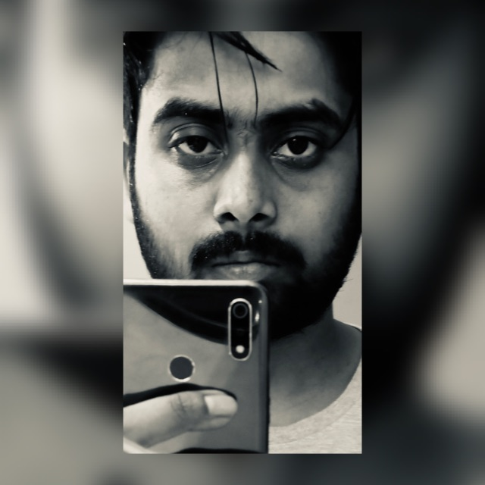
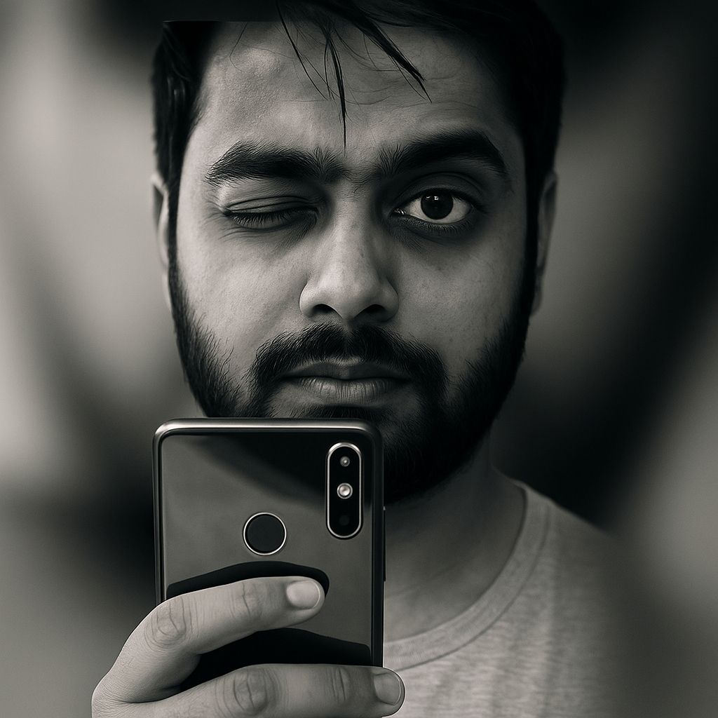
Real-World Testing
Generated a fake version of a team member using AI tools
Model was tested on unseen image
Result: Correctly predicted 4 out of 5 cases
Shows model generalizes beyond training data

Slide 12
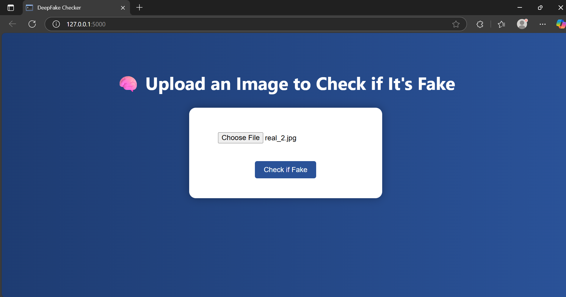
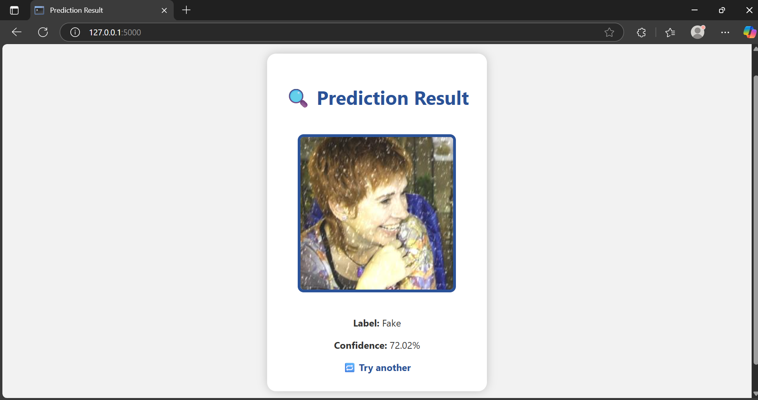
Demo Web App
Flask web app
Upload image → Get prediction (Real/Fake + confidence %)
Interface designed for easy testing

Slide 13
Conclusion & Future Work
Built two working models:
CNN (initial)
MobileNetV2 + Augmentation (final)
Final model performs better and trains faster
Fully functional evaluation + deployment
Next Steps:
Video deepfake detection
Grad-CAM integration
Feedback loop for web app

Slide 14
Thank You!

